Slide 1
SNS-blog
CMAD presentation

Slide 2
CMAD Blog application
Technologies Used :
-> Java 8
-> tomcat 7/8
-> jersey 2.2 (java framework for RESTful web service
-> Database mySql (Hibernate-JPA) and mongo (morphia)
-> Maven build 3.3
-> JWT for managing stateless authentication
-> glassfish-moxy for JSON marshalling and un-marshaling
-> Docker

Slide 3
REST APIs
 | Function | Method (HTTP) | URL | HTTP Status
1 | Add User | POST | rest/Blog/User | 200
2 | delete User | DELETE | rest/Blog/User/{uname} | 200
3 | login user | POST | rest/Blog/User/login
4 | update User | PUT | rest/Blog/User/ | 200
5 | Add Post | POST | rest/Blog/Posts | 200
6 | delete Post | DELETE | rest/Blog/Posts/{postid} | 200
7 | update Post | PUT | rest/Blog/Posts
8 | Find Post | GET | rest/Blog/Posts/{title} | 200 (list of posts)
9 | Find User's Post | GET | rest/Blog/User/{uname}/Posts | 200 (list of user's Posts)
10 | Add Comment | POST | rest/Blog/Comments | 200
11 | Delete Comment | DELETE | rest/Blog/Comments/{commentid} | 200

Slide 4
Phases of application development
Phase 1:
DB: mySql
UI: jquery
REST Calls: ajax
Jenkins: Used for creating build pipeline and creating a docker file of an Java application .
Java-DB connectivity: Hibernet (JPA)
Phase 2:
DB: mongo DB
UI: Reactjs
REST Calls: ajax, axios
Java-DB connectivity: mongodb Driver
Deployment: Google Could

Slide 5
Application architecture

Slide 6
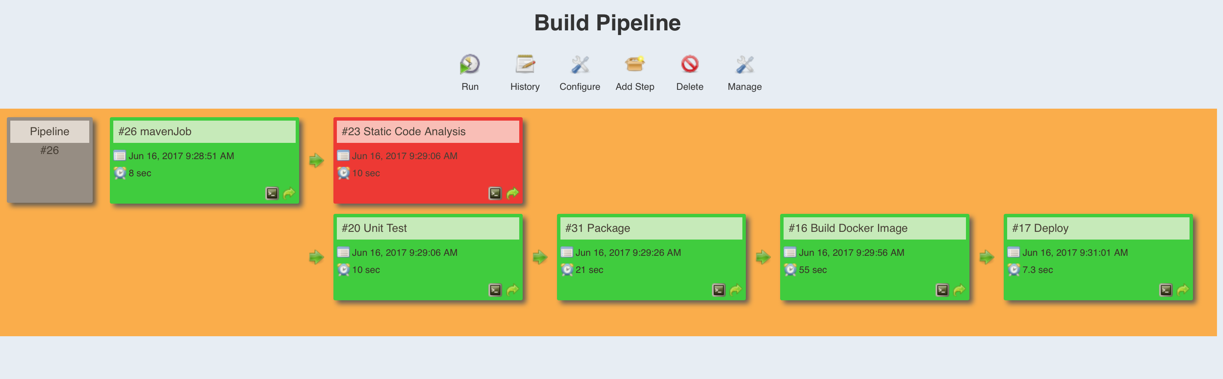
Jenkins build pipeline

Slide 7
Deployment architecture

Slide 8
Thank you !!!

